Slide 1
Project Presentation by
DEBKRISHNA MANNA
Under the supervision of Prof. Sumanta Adhya
REGISTRATION NO -1001811400206
SEMESTER-IV
Department of Statistics
West Bengal State University

Slide 2
EFFECT OF MISSING DATA ON VARIANCE FUNCTION ESTIMATION

Slide 3
OVERVIEW
What is Heteroscedasticity?
Variance Function Model in Heteroscedasticity
Estimation of Regression parameter and Variance Function.
A particular pattern of missing data in Quadratic variance function: A Simulation Study
A possible Remedy
Our main objective is to establish
Biased Estimation in Variance Function Model for a Non-ignorable missing data Process

Slide 4
Example
Y- Food Expenditure
X- Income of corresponding Family
We want to regress Y on X
Variability of Y depend on X.
Variability of Y is high for Higher income class (Higher value of X)
Variability of Y is nearly constant for Lower income class (Lower value of X).

Slide 5
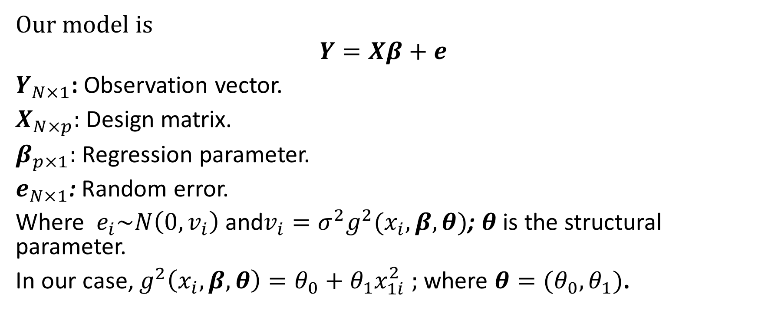
Variance Function Model
Our model is
$$Y=Xβ+e$$
$Y_{N×1}$: Observation vector.
$X_{N×p}:$Design matrix.
$β_{p×1}:$ Regression parameter.
$e_{N×1}$: Random error.
Where $e_{i}\sim N\left(0,v_{i}\right)$and$v_{i}=σ^{2}g^{2}(x_{i},β,θ)$; $θ$is the structural parameter.
In our case, $g^{2}\left(x_{i},β,θ\right)=θ_{0}+θ_{1}x_{1i}^{2} ;$ where $θ=(θ_{0},θ_{1})$.

Slide 6
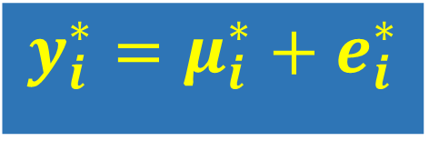
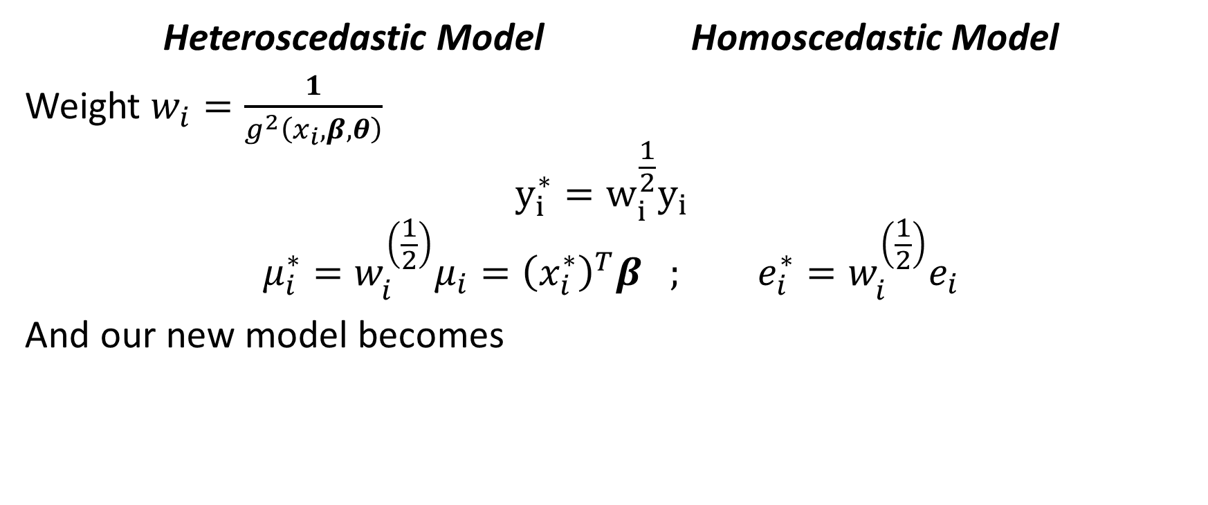
Transformation of model:
Heteroscedastic Model Homoscedastic Model
Weight $w_{i}=\frac{1}{g^{2}\left(x_{i},β,θ\right)}$
$$y_{i}^{∗}=w_{i}^{\frac{1}{2}}y_{i}$$
$$μ_{i}^{∗}=w_{i}^{\left(\frac{1}{2}\right)}μ_{i}={\left(x_{i}^{∗}\right)}^{T}β ; e_{i}^{∗}=w_{i}^{\left(\frac{1}{2}\right)}e_{i}$$
And our new model becomes
$$y_{i}^{∗}=μ_{i}^{∗}+e_{i}^{∗}$$

Slide 7


Estimation of Variance Function$(θ)$
Pseudo-likelihood:
$\dot{β}$is known
$$L\left(\dot{β},θ \right)$$
$$=−\sum_{i=1}^{N}{\ln\left[g(x_{i},\dot{β},θ)\right]}−{\left(2\right)}^{−1}\sum_{i=1}^{N}{{\left\{(y_{i}−μ_{i})∕g\left(x_{i},\dot{β},θ\right)\right\}}^{2}}$$

Slide 8
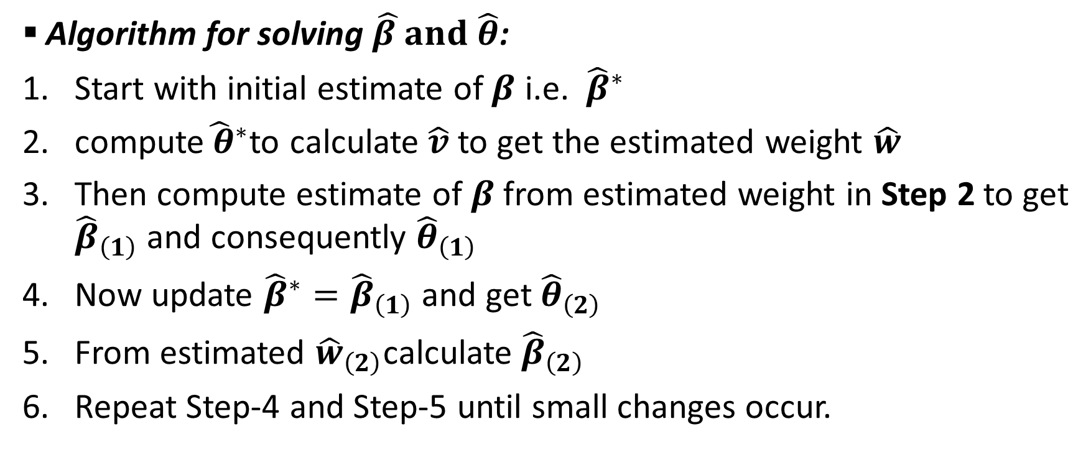

Estimation of $β and θ$
Algorithm for solving $\hat{β }and \hat{θ}$:
Start with initial estimate of $β$ i.e. ${\hat{β}}^{∗}$
compute${\hat{ θ}}^{∗}$to calculate $\hat{v}$to get the estimated weight $\hat{w}$
Then compute estimate of $β$from estimated weight in Step 2 to get ${\hat{β}}_{\left(1\right)}$ and consequently ${\hat{θ}}_{\left(1\right)}$
Now update ${\hat{β}}^{∗}={\hat{β}}_{\left(1\right)}$ and get ${\hat{θ}}_{\left(2\right)}$
From estimated ${\hat{w}}_{\left(2\right)}$calculate ${\hat{β}}_{\left(2\right)}$
Repeat Step-4 and Step-5 until small changes occur.

Slide 9
Algorithm
Data Without missing unit
Pseudo-likelihood
Generalized Least Square
To get $\hat{β}$ and $\hat{θ}$
To get 𝛽 ̂ and 𝜃 ̂
Generating the data
Pseudo-likelihood
Generalized Least Square
To get $\hat{β}$ and $\hat{θ}$
To get 𝛽 ̂ and 𝜃 ̂

Slide 10

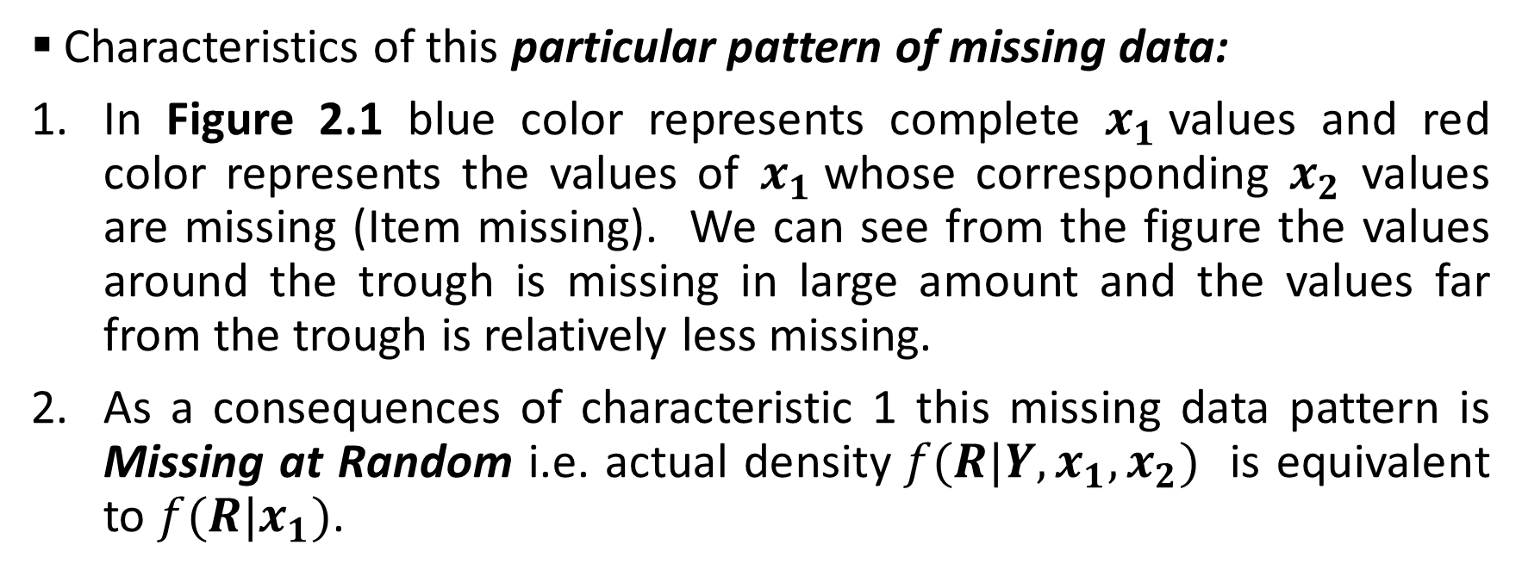
Missing data in Variance function
Characteristics of this particular pattern of missing data:
In Figure 2.1 blue color represents complete $x_{1}$values and red color represents the values of $x_{1}$whose corresponding $x_{2}$ values are missing (Item missing). We can see from the figure the values around the trough is missing in large amount and the values far from the trough is relatively less missing.
As a consequences of characteristic 1 this missing data pattern is Missing at Random i.e. actual density$f(R|Y,x_{1},x_{2})$ is equivalent to $f(R|x_{1})$.
MISSING at RANDOM $⇒$Ignorable Missing Data

Slide 11
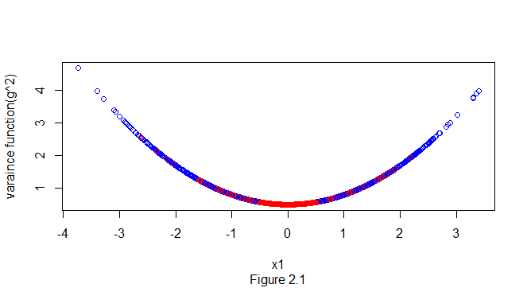
Our particular pattern of Missing data in variance function

Slide 12

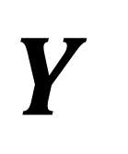

$$Y$$
$$x_{1}$$
$$x_{2}$$
missing data
pattern

Slide 13
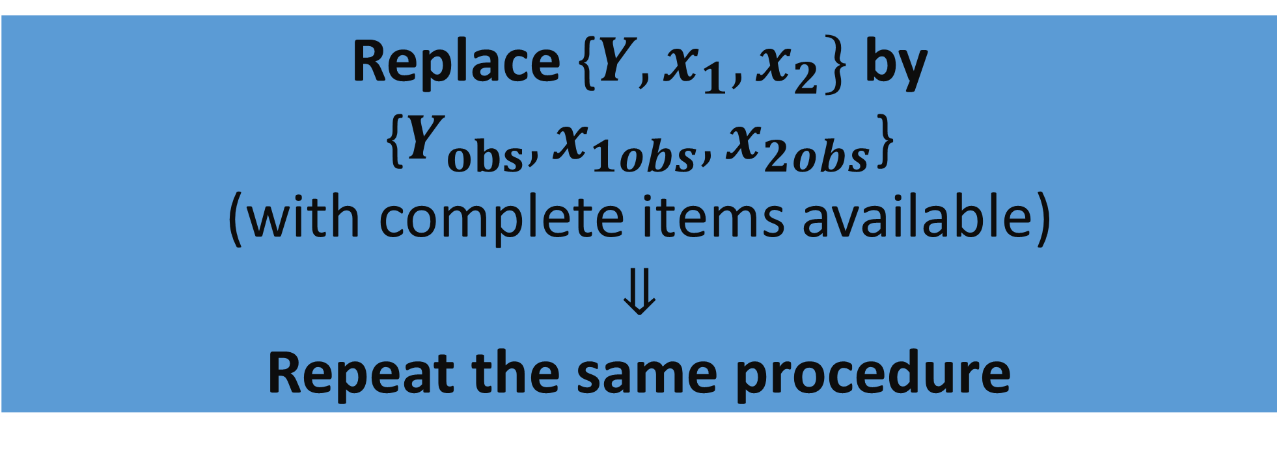

Estimation based on completely observed unit
As the Missing Data is ignorable We will completely remove those values whose corresponding $x_{2}$value is missing.
Replace {$Y,x_{1},x_{2}\}$by {$Y_{obs},x_{1obs},x_{2obs}$} (with complete items available) $$⇓$$ Repeat the same procedure

Slide 14
Ignorable Missing Data Mechanism
Usually for Ignorable Missing Data the precision decreases slightly but the bias does not affected i.e. for complete data if the estimator is unbiased it is also unbiased for data after missing.
Our objective is to show that for this particular pattern of missing data we will get biased estimation.

Slide 15
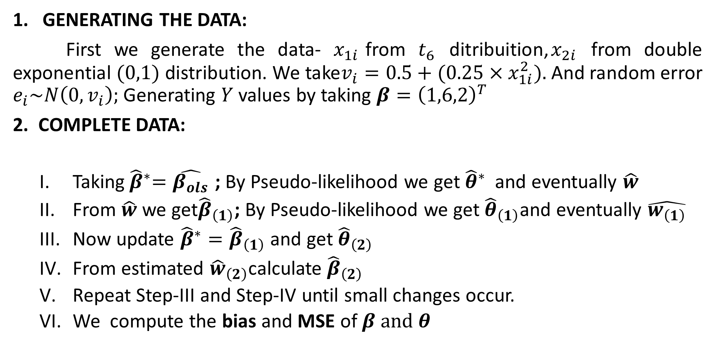
Simulation Process
GENERATING THE DATA:
First we generate the data- $x_{1i}$from $t_{6}$ ditribuition,$x_{2i}$ from double exponential$(0,1)$ distribution. We take$v_{i}=0.5+(0.25{×x}_{1i}^{2}).$ And random error $e_{i}\sim N\left(0,v_{i}\right);$ Generating $Y$values by taking $β={\left(1,6,2\right)}^{T}$
2. COMPLETE DATA:
  Taking${ \hat{β}}^{∗}=\hat{β_{ols}}$ ; By Pseudo-likelihood we get ${\hat{θ}}^{∗}$ and eventually $\hat{w}$
  From $\hat{w}$ we get${\hat{β}}_{\left(1\right)}$; By Pseudo-likelihood we get ${\hat{θ}}_{\left(1\right)}$and eventually $\hat{w_{\left(1\right)}}$
  Now update ${\hat{β}}^{∗}={\hat{β}}_{\left(1\right)}$ and get ${\hat{θ}}_{\left(2\right)}$
  From estimated ${\hat{w}}_{\left(2\right)}$calculate ${\hat{β}}_{\left(2\right)}$
  Repeat Step-III and Step-IV until small changes occur.
  We compute the bias and MSE of $β and θ$

Slide 16
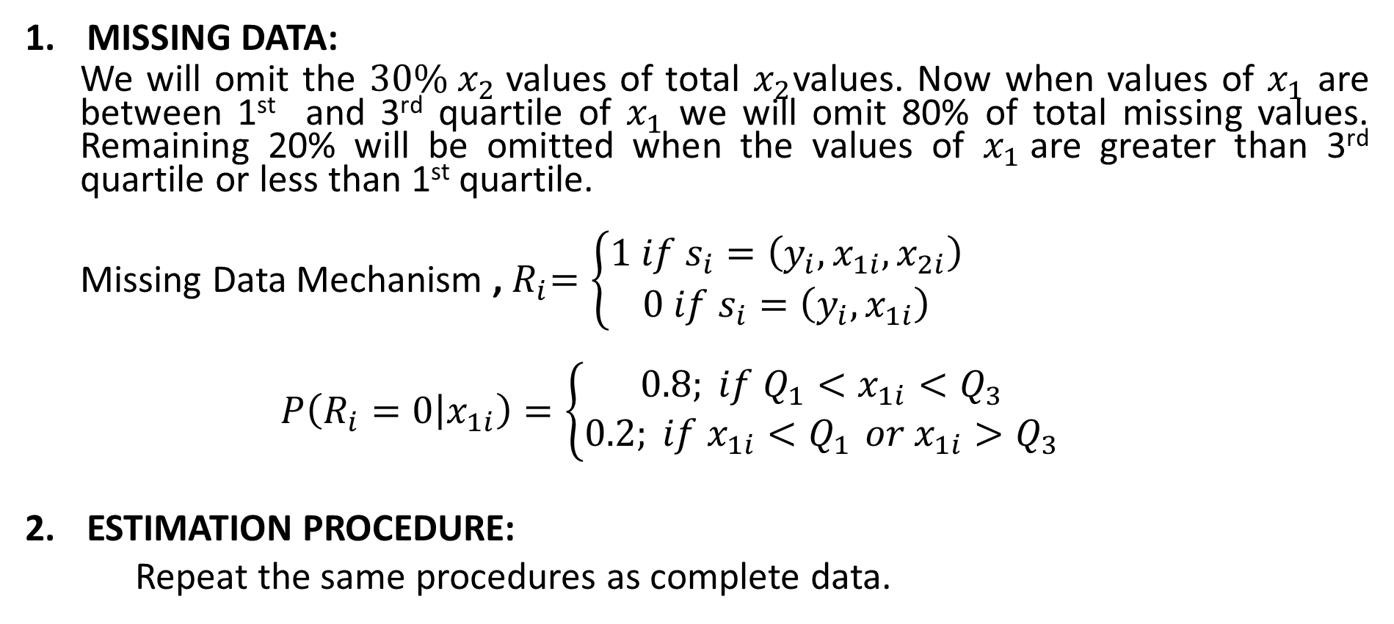
Simulation Process
MISSING DATA:
  We will omit the $30\% x_{2}$values of total $x_{2}$values. Now when values of $x_{1}$ are between 1st and 3rd quartile of $x_{1}$ we will omit 80% of total missing values. Remaining 20% will be omitted when the values of $x_{1}$are greater than 3rd quartile or less than 1st quartile.
  Missing Data Mechanism ,${ R}_{i}=\left\{\begin{aligned}1 if s_{i}=\left(y_{i},x_{1i},x_{2i}\right) \\ 0 if s_{i}=\left(y_{i},x_{1i}\right)\end{aligned}\right.$
  $$P\left(R_{i}=0 | x_{1i}\right)=\left\{\begin{aligned}0.8; if Q_{1}<x_{1i}<Q_{3} \\ 0.2; if x_{1i}<Q_{1 }or x_{1i}>Q_{3}\end{aligned}\right.$$
ESTIMATION PROCEDURE:
Repeat the same procedures as complete data.

Slide 17
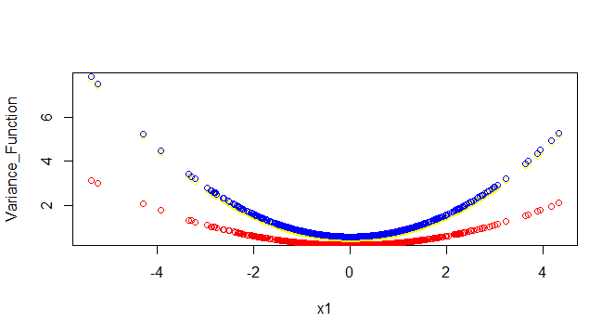
Estimated Variance function for Complete DATA (BLUE) and DATA without missing unit(RED)

Slide 18

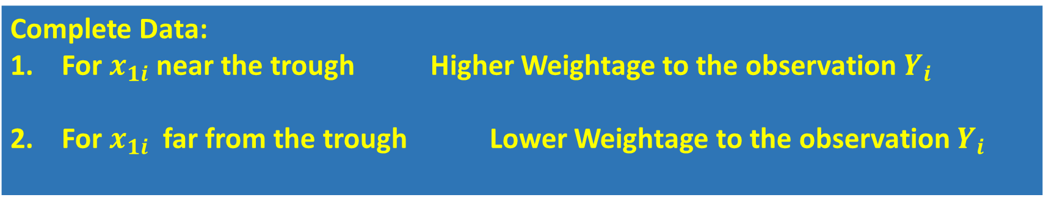
Discussion
For complete data (Blue) we can see the we have estimated the variance function very precisely. Its quadratic shape almost remain intact. But for the observed data (Red) its almost flat line.
Complete Data: For $x_{1i}$ near the trough Higher Weightage to the observation $Y_{i}$ For $x_{1i}$ far from the trough Lower Weightage to the observation $Y_{i}$
Data without missing unit: All values of $x_{1}$ Almost Equal Weightage to all the observations $Y$

Slide 19
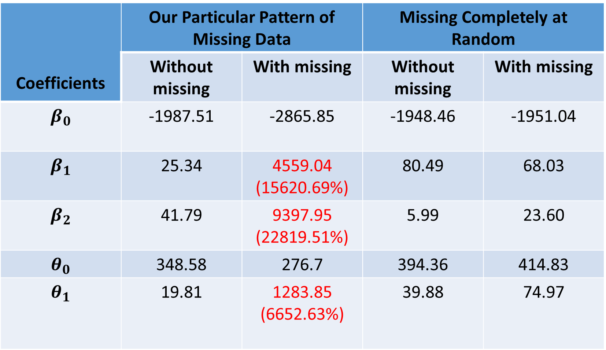
Table for comparing Bias of $β$ and $θ(×10^{4} Scale)$
Coefficients | Our Particular Pattern of Missing Data |  | Missing Completely at Random
 | Without missing | With missing | Without missing | With missing
$$β_{0}$$ | -1987.51 | -2865.85 | -1948.46 | -1951.04
$$β_{1}$$ | 25.34 | 4559.04 (15620.69%) | 80.49 | 68.03
$$β_{2}$$ | 41.79 | 9397.95 (22819.51%) | 5.99 | 23.60
$$θ_{0}$$ | 348.58 | 276.7 | 394.36 | 414.83
$$θ_{1}$$ | 19.81 | 1283.85 (6652.63%) | 39.88 | 74.97

Slide 20
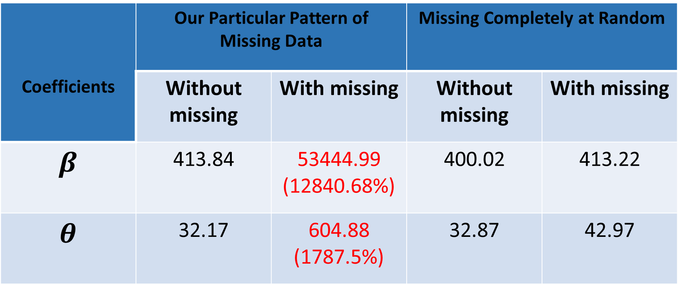

Table for comparing Mean Square Error of $β$ and $θ(×10^{4} scale)$
Coefficients | Our Particular Pattern of Missing Data |  | Missing Completely at Random
 | Without missing | With missing | Without missing | With missing
$$β$$ | 413.84 | 53444.99 (12840.68%) | 400.02 | 413.22
$$θ$$ | 32.17 | 604.88 (1787.5%) | 32.87 | 42.97

Slide 21
References
Variance Function Estimation by M. Davidian and R. J. Carroll. Journal of the American Statistical Association. Vol. 82, No. 400 (Dec., 1987), pp. 1079-1091.
Transformation and Weighting in Regression (Chapman & Hall/CRC Monographs on Statistics and Applied Probability) by Raymond J. Carroll, David Ruppart (Author).
Statistical Analysis with Missing Data by Donald Rubin and Roderick J. A. Little.
Inference and missing data by DONALD B. RUBIN. Biometrika, Volume 63, Issue 3, December 1976, Pages 581–592

Slide 22
THANK YOU!!

